Slide 1


Faculty Module

Slide 2
Team Members: Beshoy Amir George Mathew Magdy Saad

Slide 3
This module consist of three tables, first one for faculty departments, second one for subjects for each department and the last one for student information.
Faculty Module

Slide 4
Department Table

Slide 5
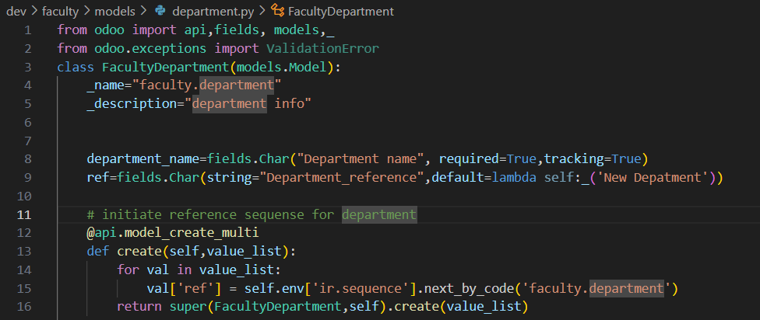
Department Table(.py)

Slide 6
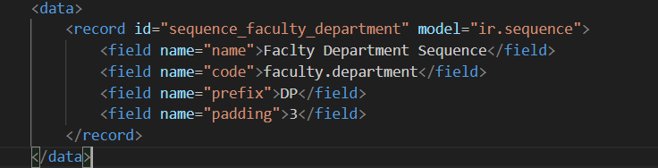
Sequence(.xml)
In this file we customize sequence details

Slide 7
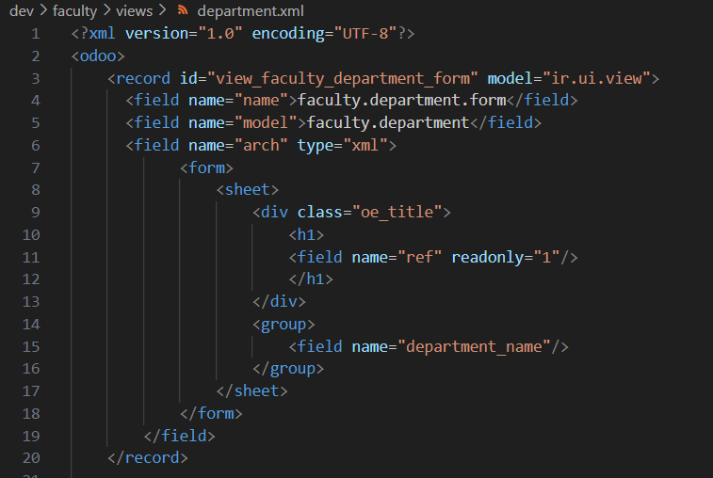
Department-view(.xml) (Form)
In this part of file, we customize the way the table is displayed in the module as form.

Slide 8
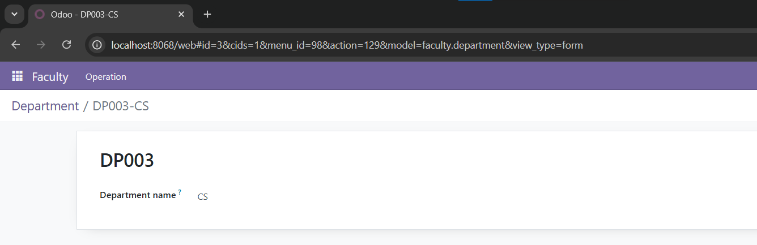
Department-view(.xml) (Form)
This screen show how file works the table is displayed in the module.

Slide 9
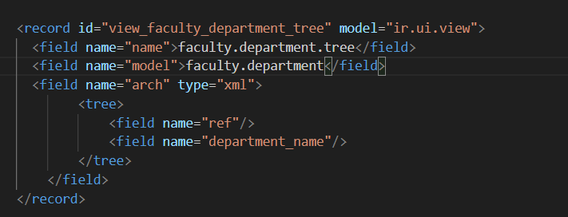
Department-view(.xml) (Tree)
In this part of file, we customize the way the table is displayed in the module as tree.

Slide 10
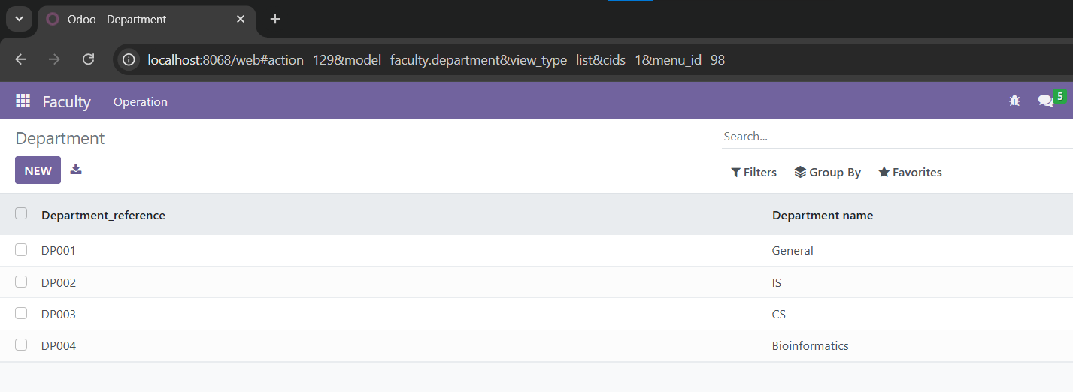
Department-view(.xml) (Tree)
This screen show how file works the table is displayed in the module.

Slide 11
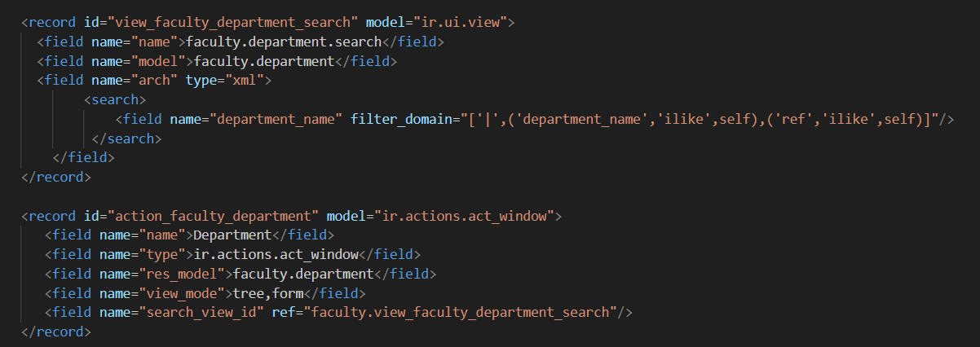
Department-view(.xml) (Search)
In this part of file, we customize the way we will search with in this table in the module.

Slide 12
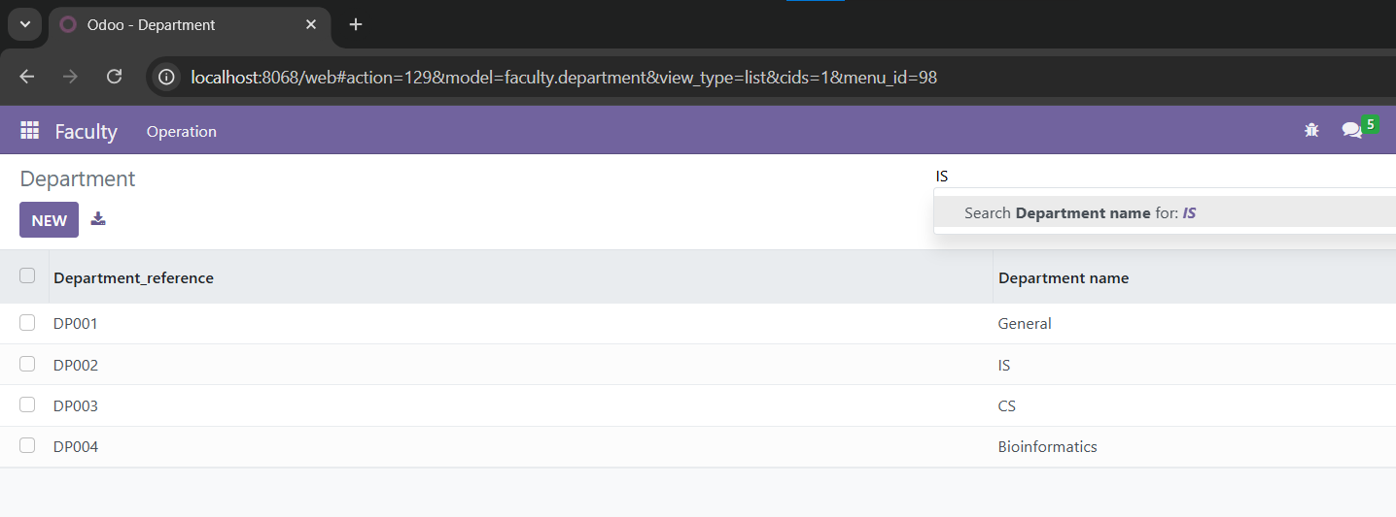
Department-view(.xml) (Search)
This screen show how file works the table is displayed in the module.

Slide 13
Subject Table

Slide 14
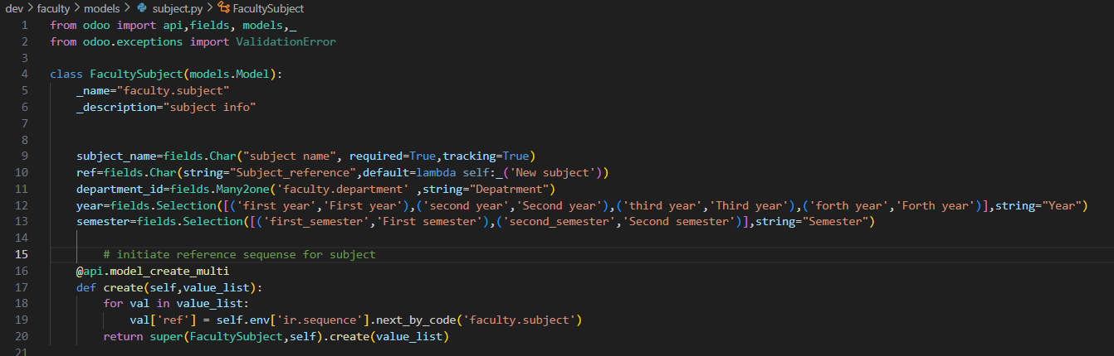
Subject Table(.py)

Slide 15
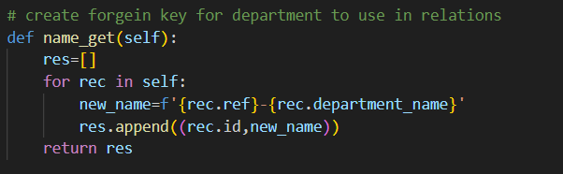
Subject Table(.py) (Relation with Department)
In this table we inherit reference and name from department table to create many to one relation between subject table and department table
This function from department table

Slide 16
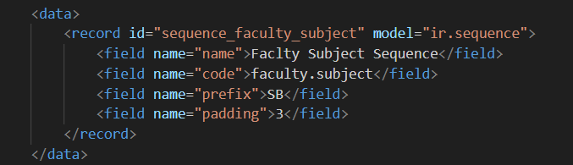
Sequence(.xml)
In this file we customize sequence details

Slide 17
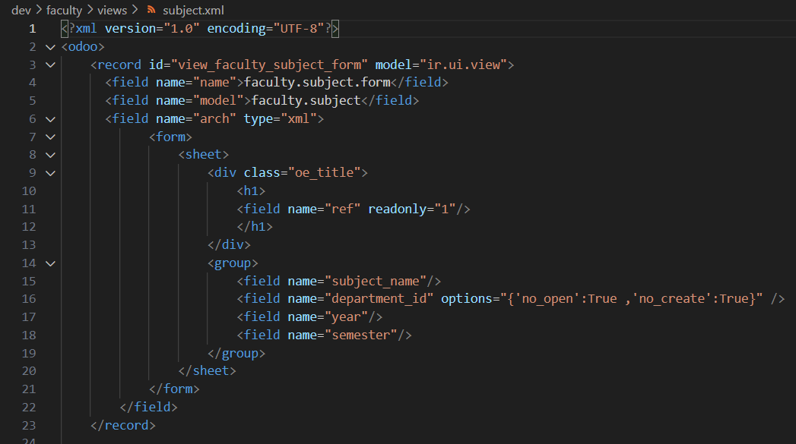
Subject-view(.xml) (Form)
In this part of file, we customize the way the table is displayed in the module as form.

Slide 18
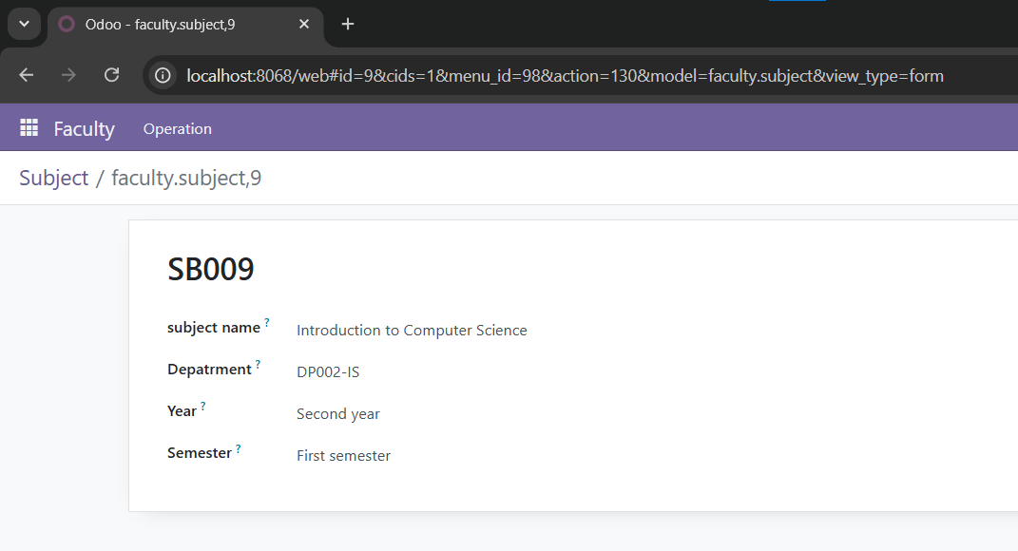
Subject-view(.xml) (Form)
This screen show how file works the table is displayed in the module.

Slide 19
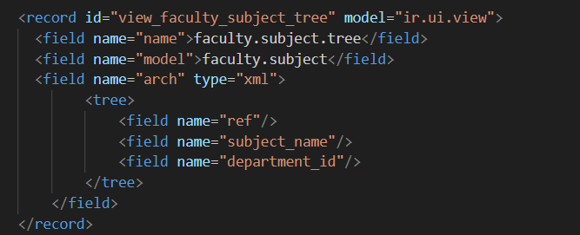
Subject-view(.xml) (Tree)
In this part of file, we customize the way the table is displayed in the module as tree.

Slide 20
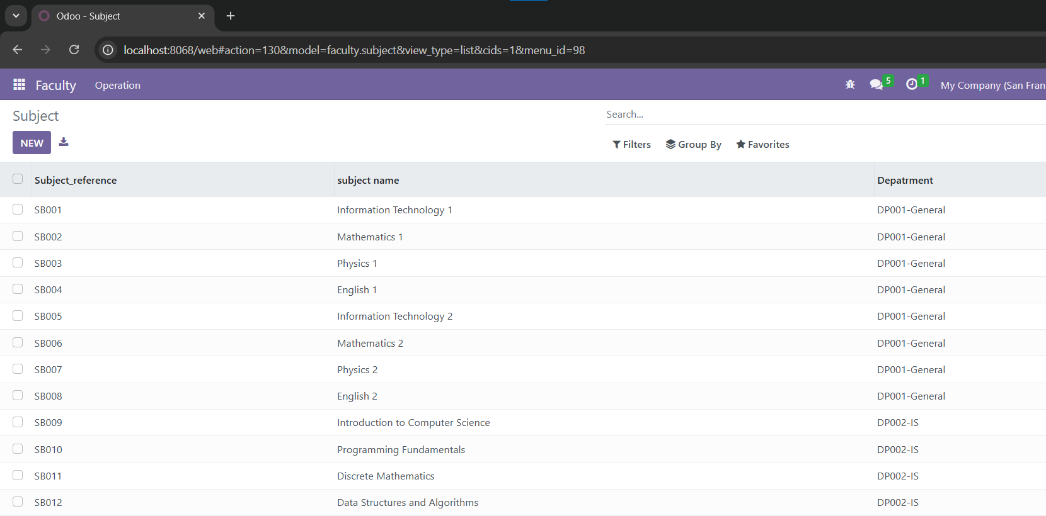
Subject-view(.xml) (Tree)
This screen show how file works the table is displayed in the module.

Slide 21
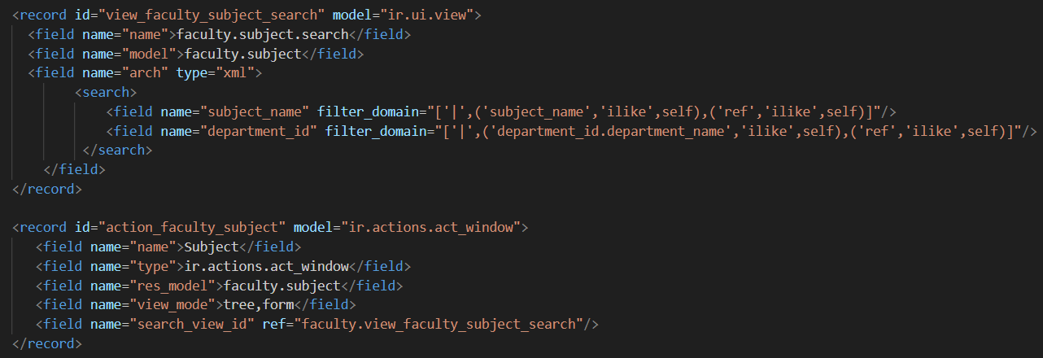
Subject-view(.xml) (Search)
In this part of file, we customize the way we will search with in this table in the module.

Slide 22
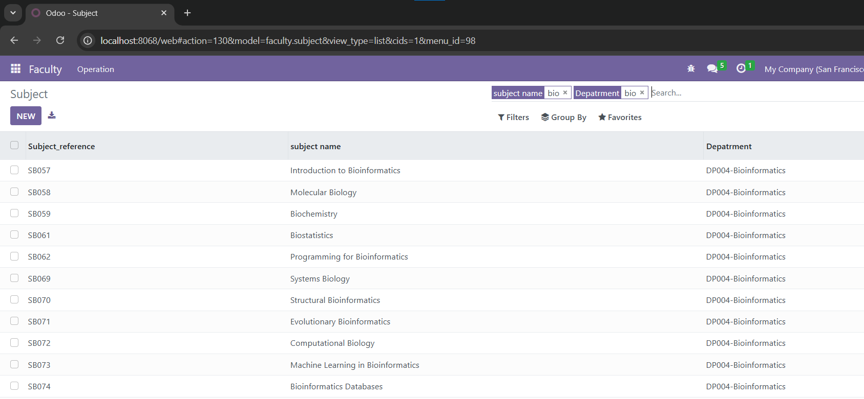
Subject-view(.xml) (Search)
This screen show how file works the table is displayed in the module.

Slide 23
Student Table

Slide 24
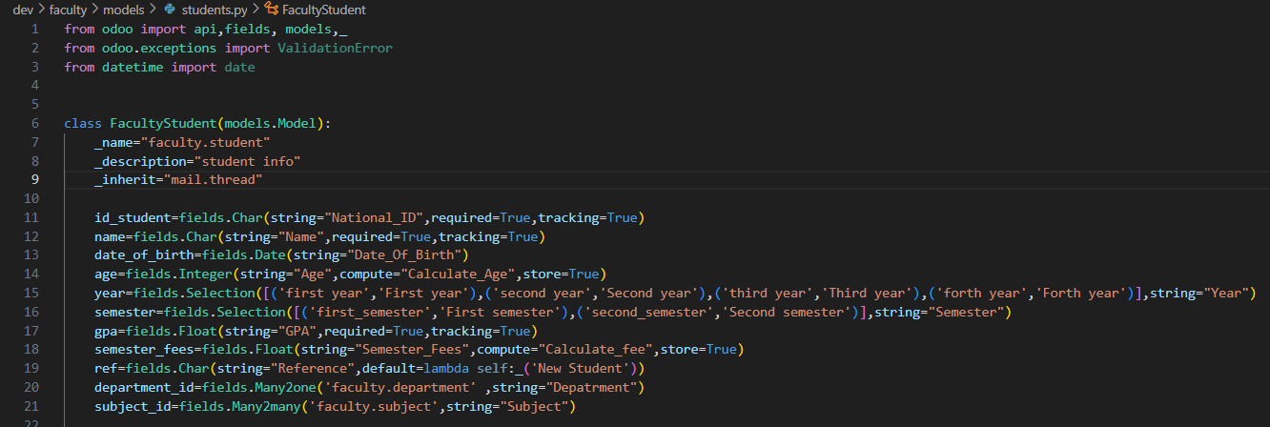
Student Table(.py)

Slide 25
Student Table(.py) (Relation with Department)
In this table we inherit reference and name from department table to create many to one relation between student table and department table.
This function from department table

Slide 26
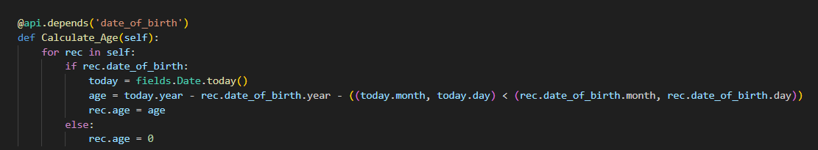
Student Table(.py)
This function takes birth date from user and calculate his age.

Slide 27
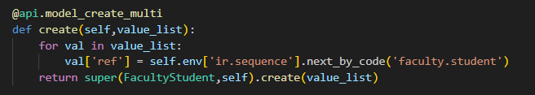
Student Table(.py)
This function generates sequence of references for each student and we also used this function in all tables in this module.

Slide 28
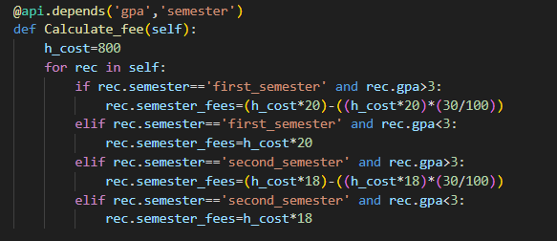
Student Table(.py)
This function calculates semester fees and takes GPA for each student and determine if he deserve discount or not.

Slide 29
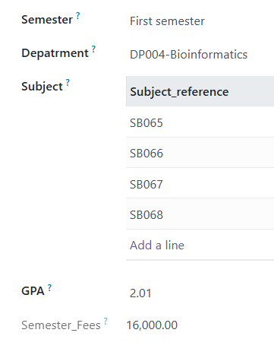
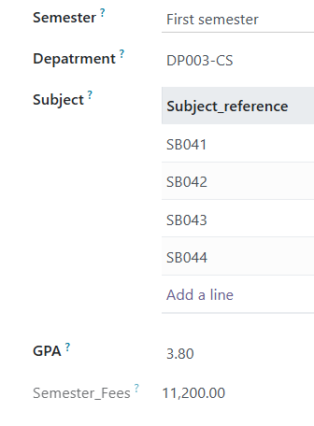
Student Table(.py) (Example)

Slide 30
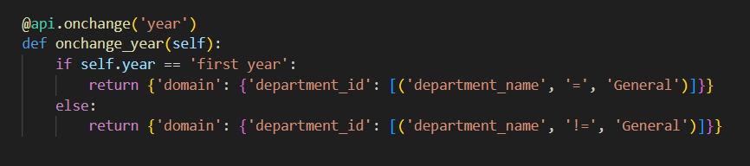
Student Table(.py)
This function specify departments available for the student depends on his educational year.

Slide 31
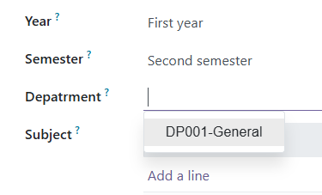
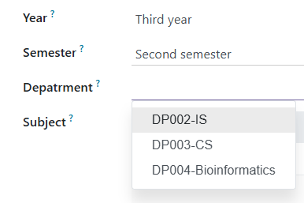
Student Table(.py) (Example)

Slide 32
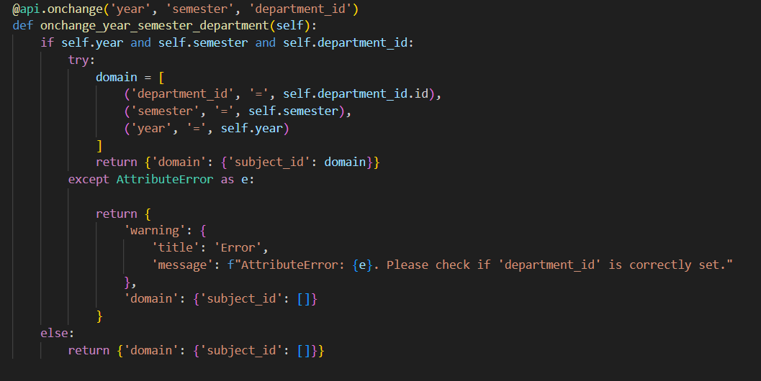
Student Table(.py)
This function shows to student the available subjects for him depends on his year , semester and department.

Slide 33
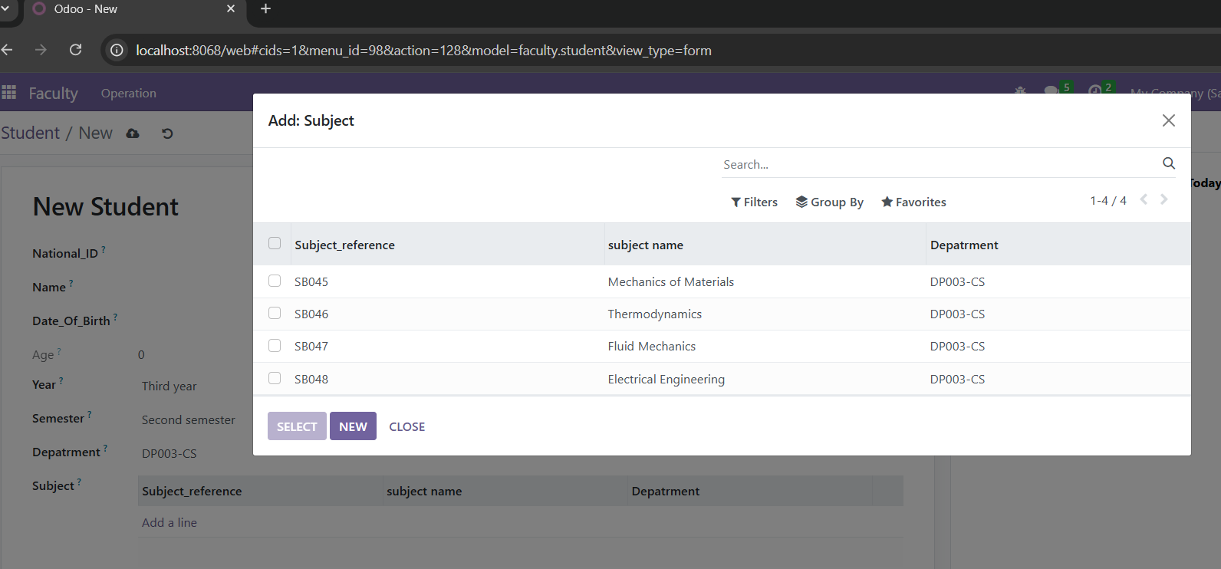
Student Table(.py) (Example)

Slide 34
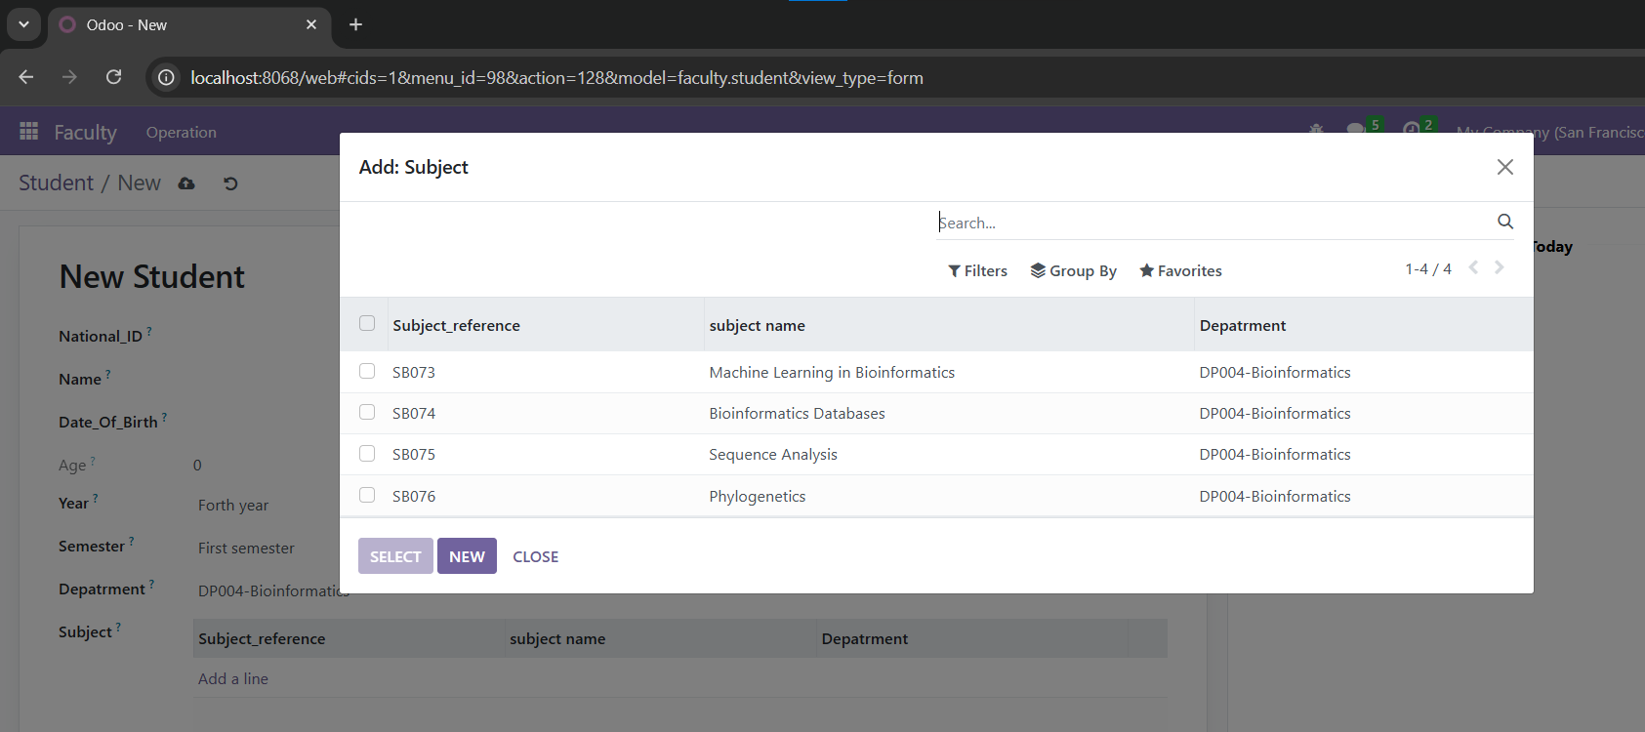
Student Table(.py) (Example)

Slide 35
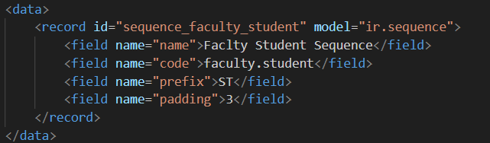
Sequence(.xml)
In this file we customize sequence details

Slide 36
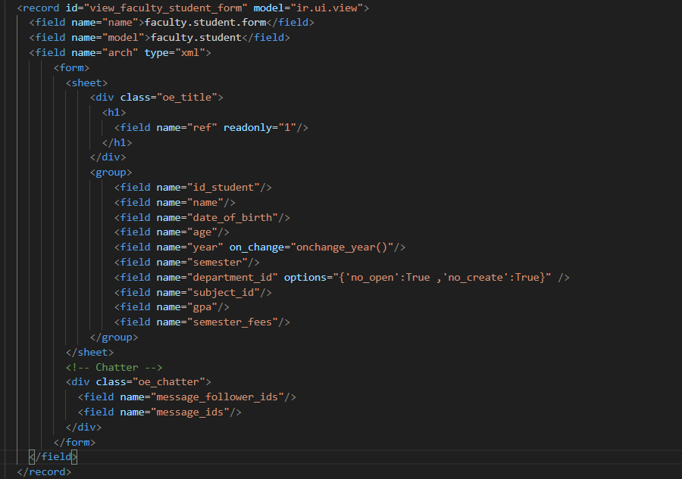
Student-view(.xml) (Form)
In this part of file, we customize the way the table is displayed in the module as form.

Slide 37
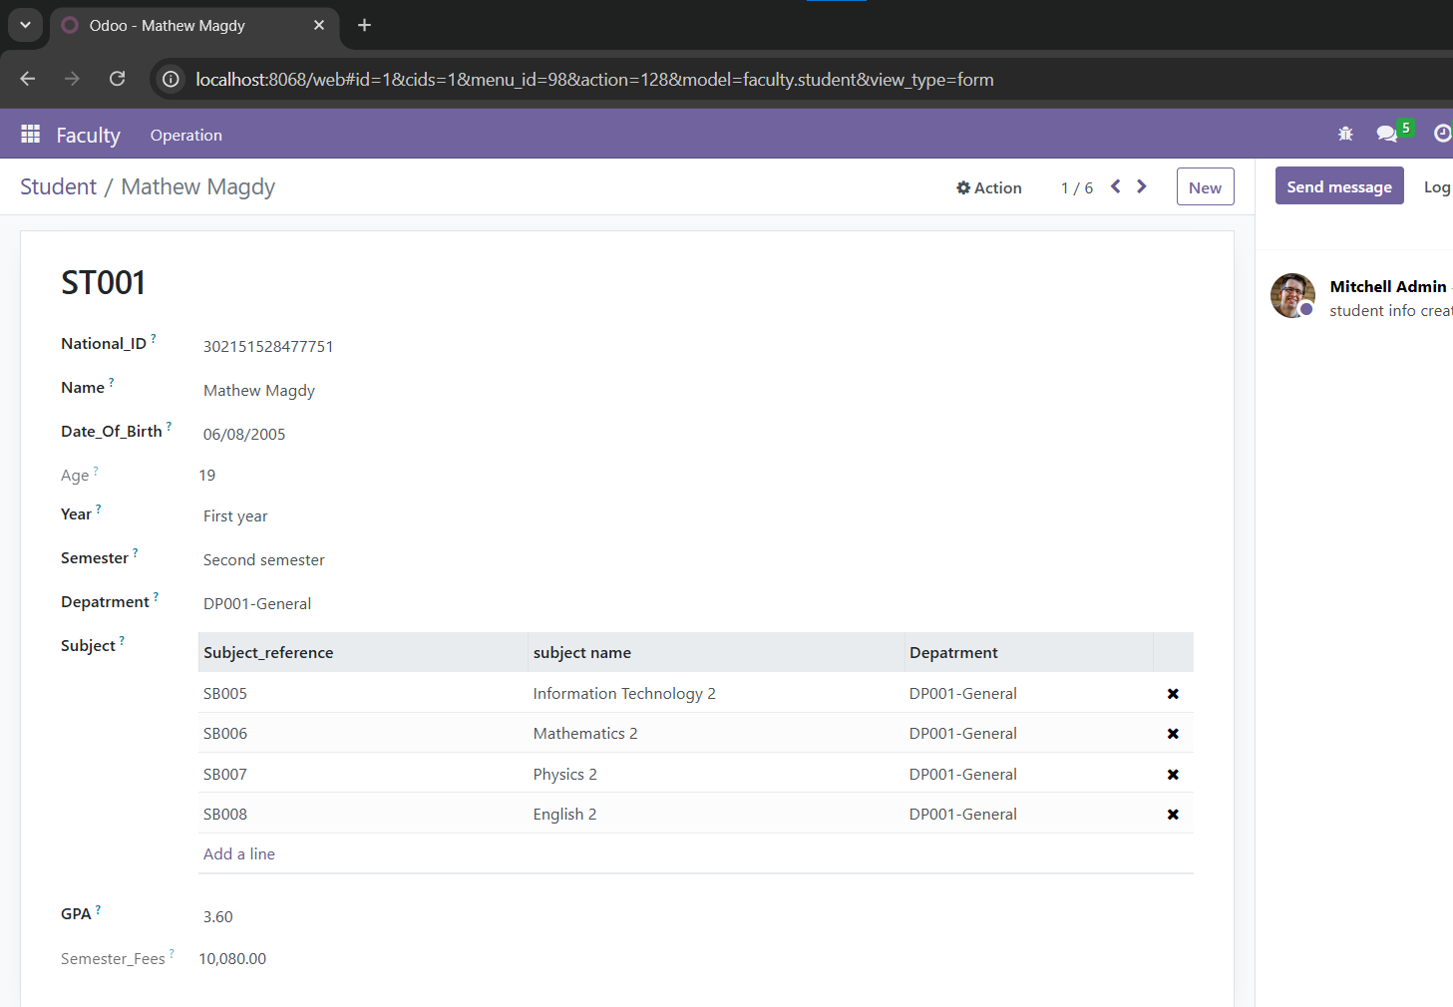
Student-view(.xml) (Form)
This screen show how file works the table is displayed in the module.

Slide 38
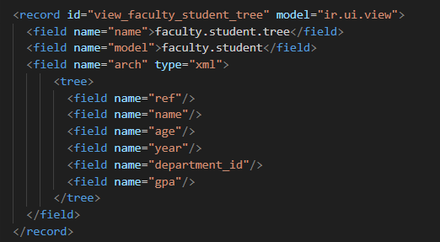
Student-view(.xml) (Tree)
In this part of file, we customize the way the table is displayed in the module as tree.

Slide 39
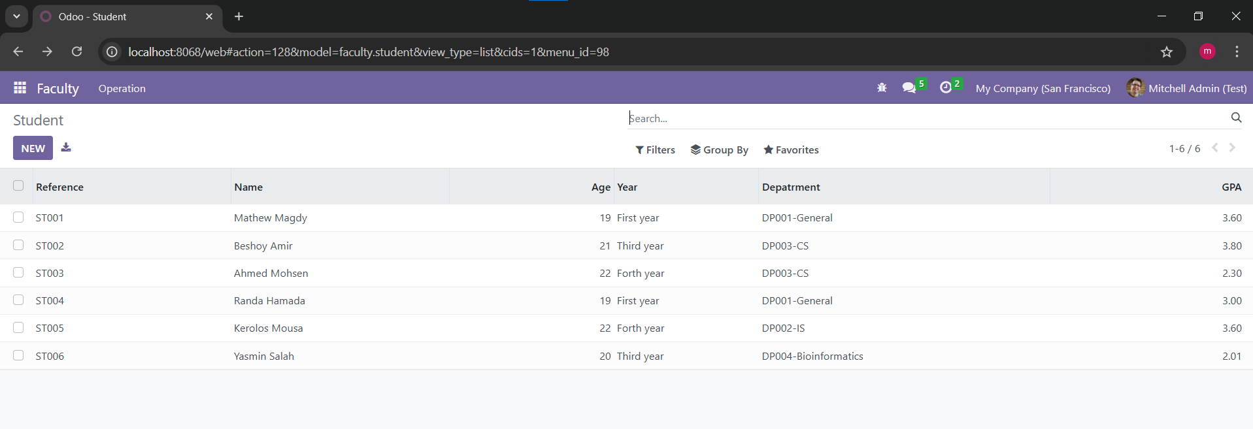
Student-view(.xml) (Tree)
This screen show how file works the table is displayed in the module.

Slide 40
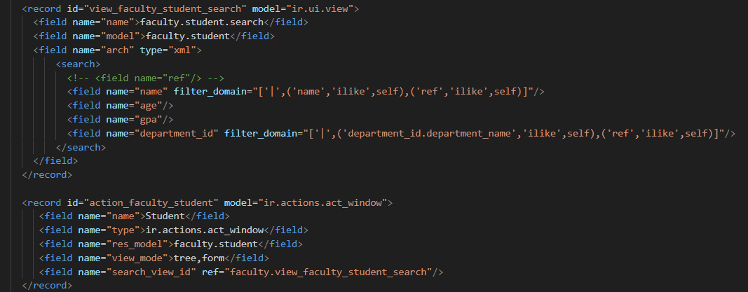
Student-view(.xml) (Search)
In this part of file, we customize the way we will search with in this table in the module.

Slide 41
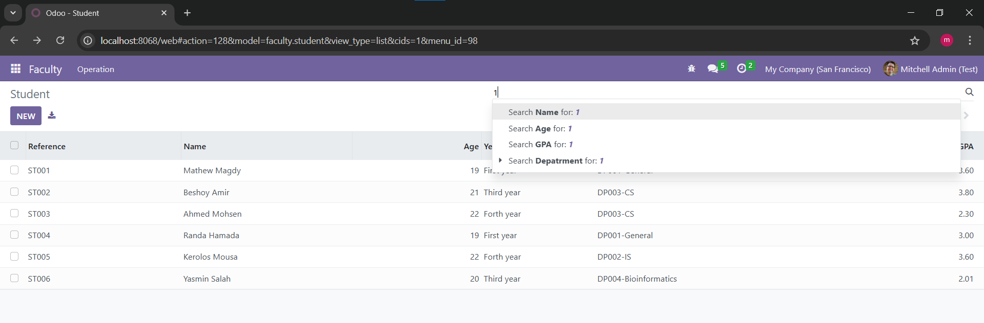
Student-view(.xml) (Search)
This screen show how file works the table is displayed in the module.

Slide 42
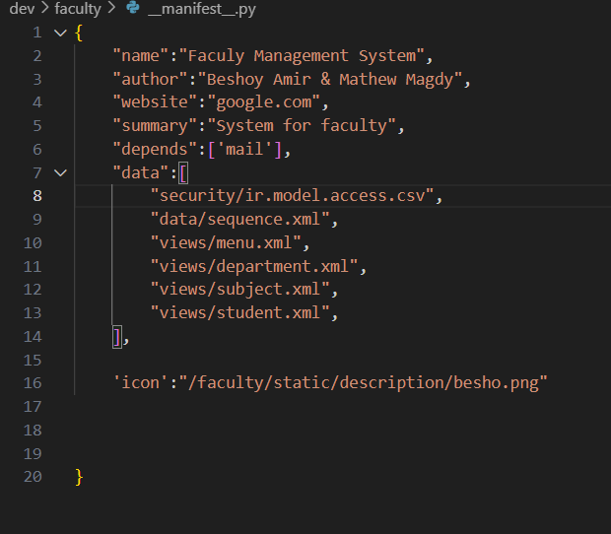
Manifest Module file(.py)

Slide 43
THANK YOU !

